Slide 1

MBE 713: Marine Population Dynamics Lecture 2: Exponential population growth
Elizabeth A. Babcock

Slide 2
Abundance N_{t}
Birth, Death, Immigration, Emigration
In any given unit of time t
B_{t} = Number of animals born
D_{t} = Number of dead animals
I_{t} = Number of immigrants
E_{t} = Number of Emigrants

Slide 3
Changes in abundance
N_{t} = Number of fish in time t
N_{t+1} = N_{t} + B_{t} – D_{t} + I_{t} – E_{t}
Change Δ in abundance
N_{t+1} - N_{t} = Δ N = B_{t} – D_{t} + I_{t} – E_{t}
In a closed population I_{t} = E_{t} = 0 so
Δ N_{t} = B_{t} – D_{t}

Slide 4
Per capita rates
Per individual birth and death rates

Slide 5

Per capita change in abundance
$$\frac{ΔN_{t}}{N_{t}} = b_{t } − d_{t}$$
These are rates (animals per animal)
they have no units

Slide 6
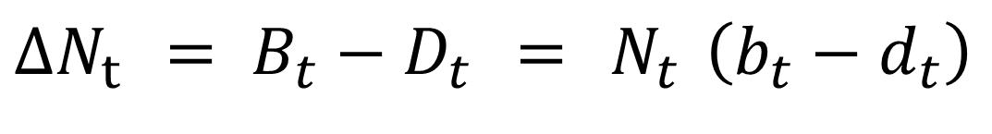
Change in abundance expressed as a function of per capita rates and abundance
$$ΔN_{t} = B_{t}−D_{t} = N_{t} \left(b_{t}−d_{t}\right)$$

Slide 7
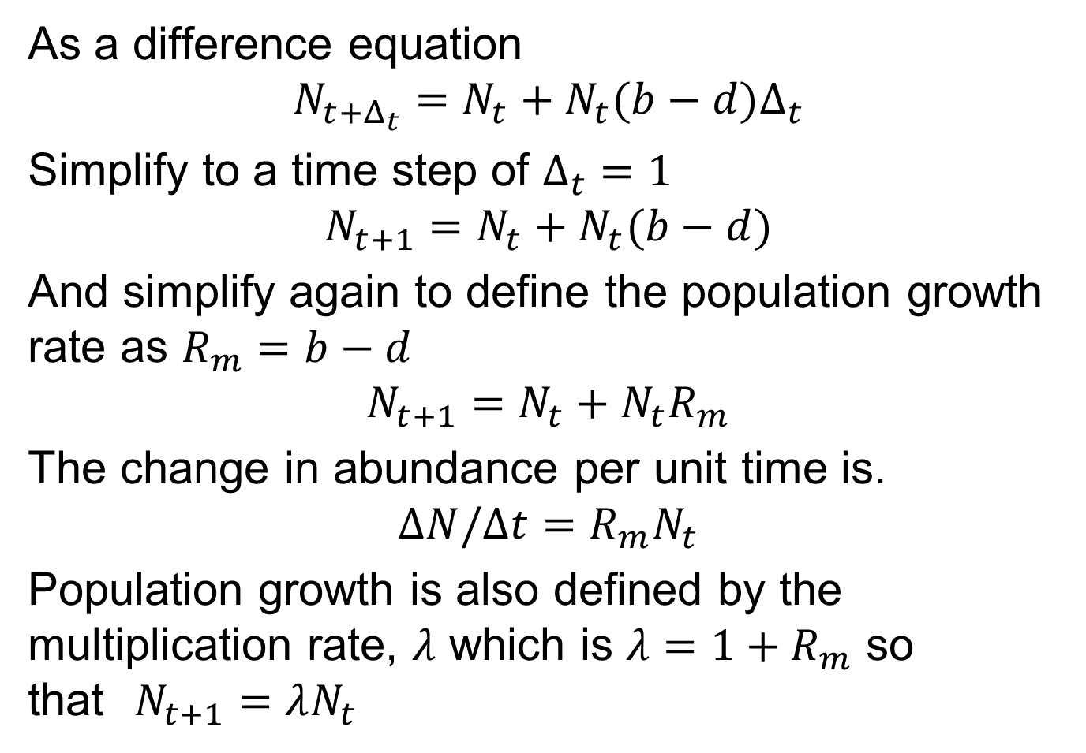
Annual time step difference equation
As a difference equation
$$N_{t+Δ_{t}}=N_{t}+N_{t}(b−d)Δ_{t}$$
Simplify to a time step of $Δ_{t}=1$
$$N_{t+1}=N_{t}+N_{t}(b−d)$$
And simplify again to define the population growth rate as $R_{m}=b−d$
$$N_{t+1}=N_{t}+N_{t}R_{m}$$
The change in abundance per unit time is.
$$ΔN/Δt=R_{m}N_{t}$$
Population growth is also defined by the multiplication rate, $λ$ which is $λ=1+R_{m}$ so that$N_{t+1}=λN_{t}$

Slide 8
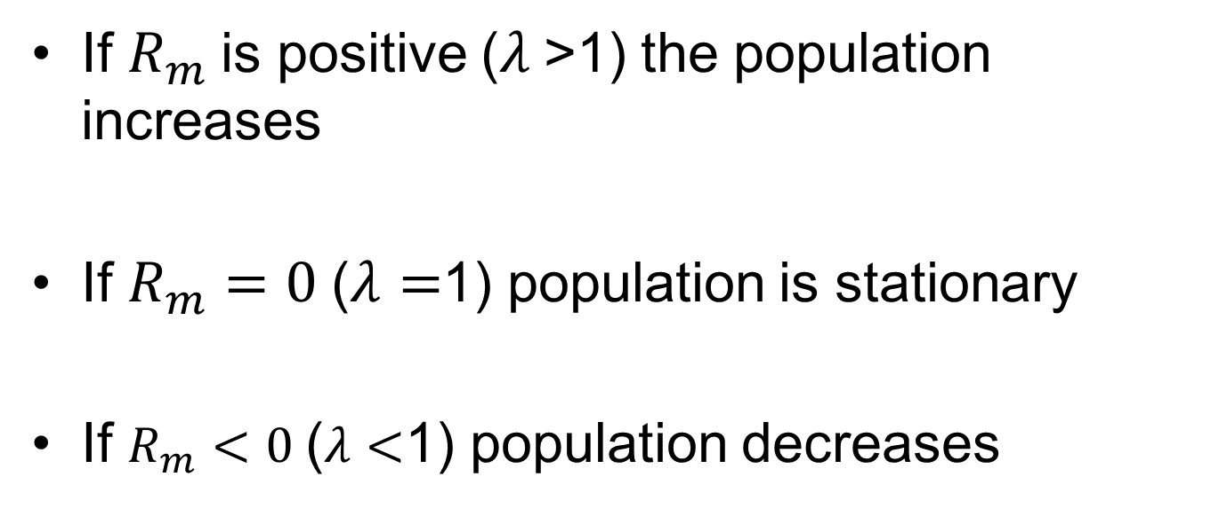
Population growth rates
If $R_{m}$is positive ($λ$>1) the population increases
If $R_{m}=0$($λ=$1) population is stationary
If $R_{m}<0$($λ<$1) population decreases

Slide 9
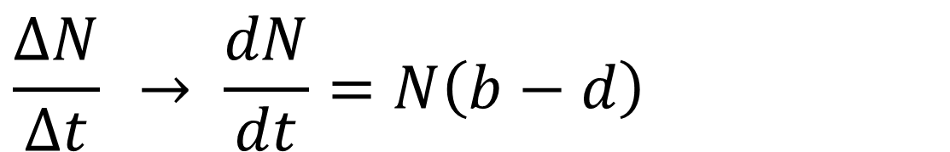
Instantaneous rates
If = t → 0
Where r is the population growth rate
Sometimes called r_{m} to indicate that it is the fundamental parameter, not realized value
Now r, b and d are instantaneous rates
$$\frac{ΔN}{Δt} → \frac{dN}{dt}=N\left(b−d\right)$$

Slide 10

Integrate to get Nt
$$\frac{dN}{dt}=r N \int_{No}^{Nt}{\frac{1}{N}}dN=\int{r dt}$$ $$LnN_{t}−LnN_{0} = rt =Ln\frac{N_{t}}{N_{0}}$$ $$\frac{N_{t}}{N_{0}} = e^{rt} N_{t} = N_{0}e^{rt}$$

Slide 11
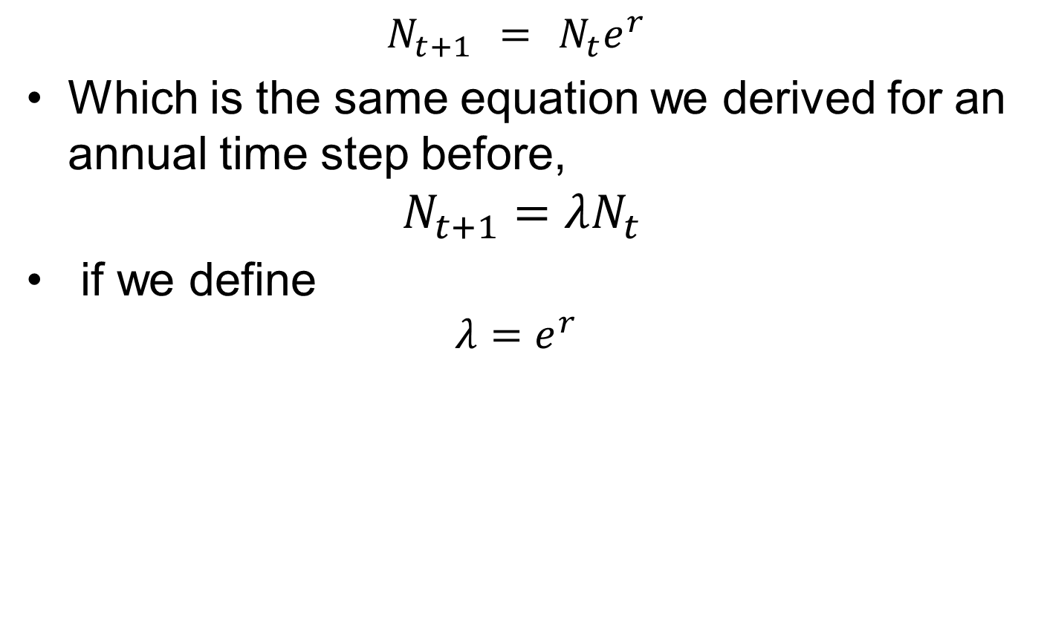
For annual time step
$$N_{t+1} = N_{t}e^{r}$$
Which is the same equation we derived for an annual time step before,
$$N_{t+1}=λN_{t}$$
if we define
$$λ=e^{r}$$

Slide 12
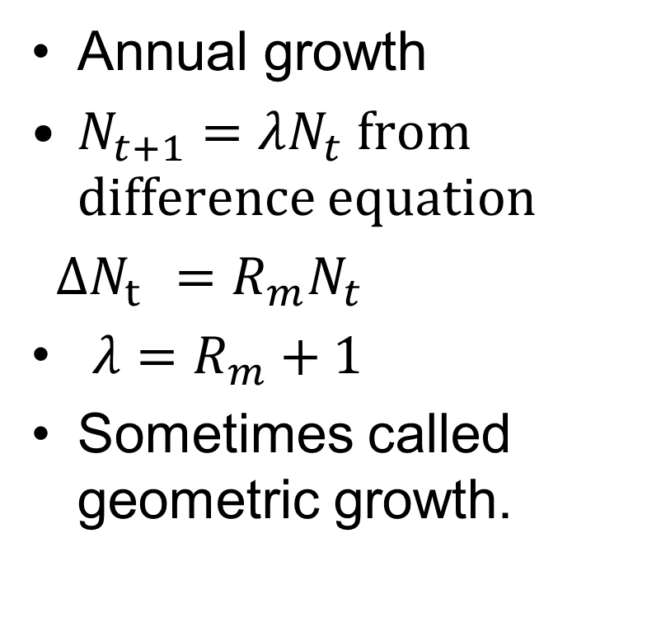
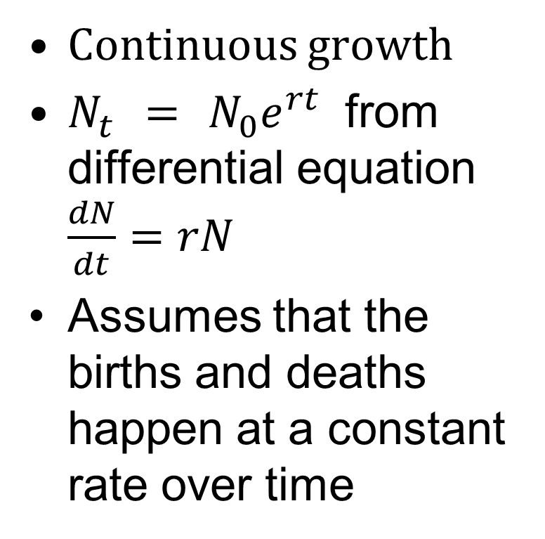
Discrete vs. continuous exponential growth equations
Continuous growth
$N_{t} = N_{0}e^{rt}$ from differential equation $\frac{dN}{dt}=rN$
Assumes that the births and deaths happen at a constant rate over time
Annual growth
$N_{t+1}=λN_{t}$ from difference equation
$ΔN_{t} =R_{m}N_{t}$
$λ=R_{m}+1$
Sometimes called geometric growth.

Slide 13
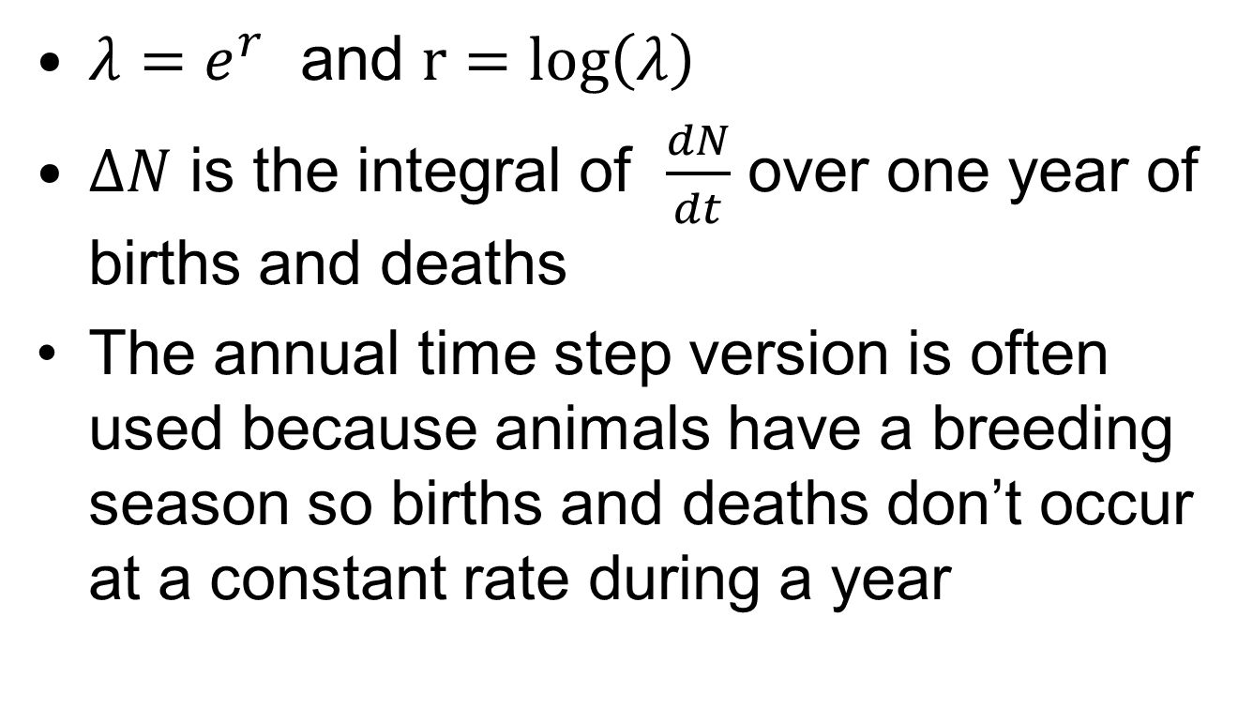
Discrete vs. continuous
${λ=e}^{r}$ and $r=log\left(λ\right)$
$ΔN$ is the integral of $\frac{dN}{dt}$ over one year of births and deaths
The annual time step version is often used because animals have a breeding season so births and deaths don’t occur at a constant rate during a year

Slide 14
Applications
Geometric growth is useful for tracking short term changes in growth
Extrapolate current trends
Fisheries models more often incorporate density dependence (next week)
Demographic models, e.g. Leslie matrix models use exponential growth models, common for protected species.

Slide 15
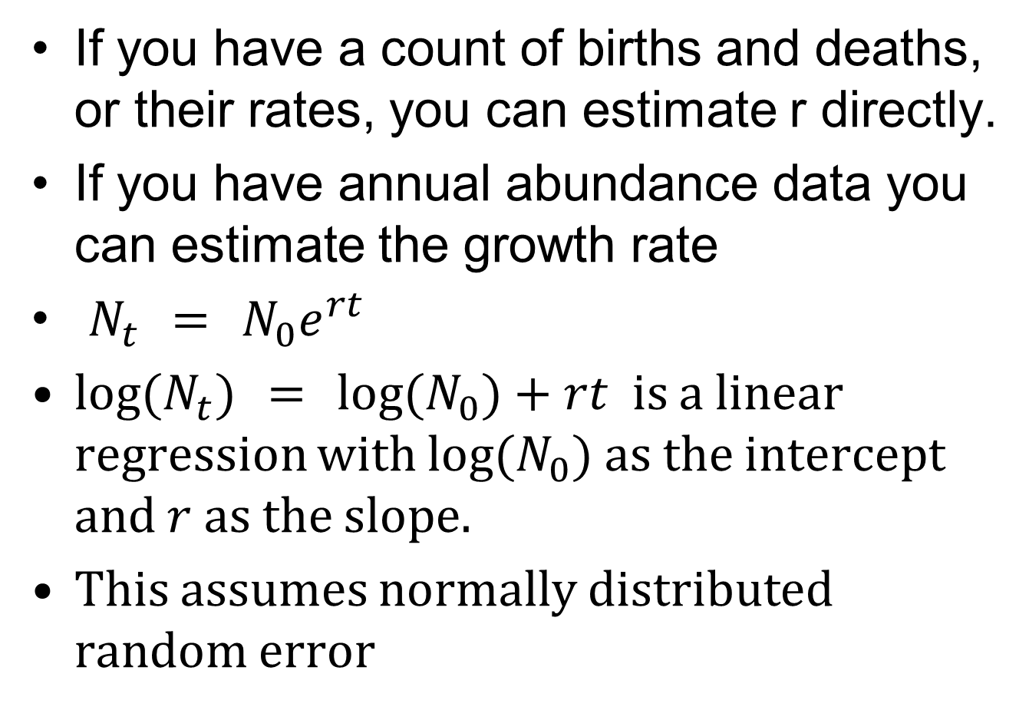
Estimating the growth rate
If you have a count of births and deaths, or their rates, you can estimate r directly.
If you have annual abundance data you can estimate the growth rate
$N_{t} = N_{0}e^{rt}$
${log⁡(N}_{t}) = {log⁡(N}_{0})+rt$ is a linear regression with ${log⁡(N}_{0})$ as the intercept and $r$ as the slope.
This assumes normally distributed random error

